Slide 1


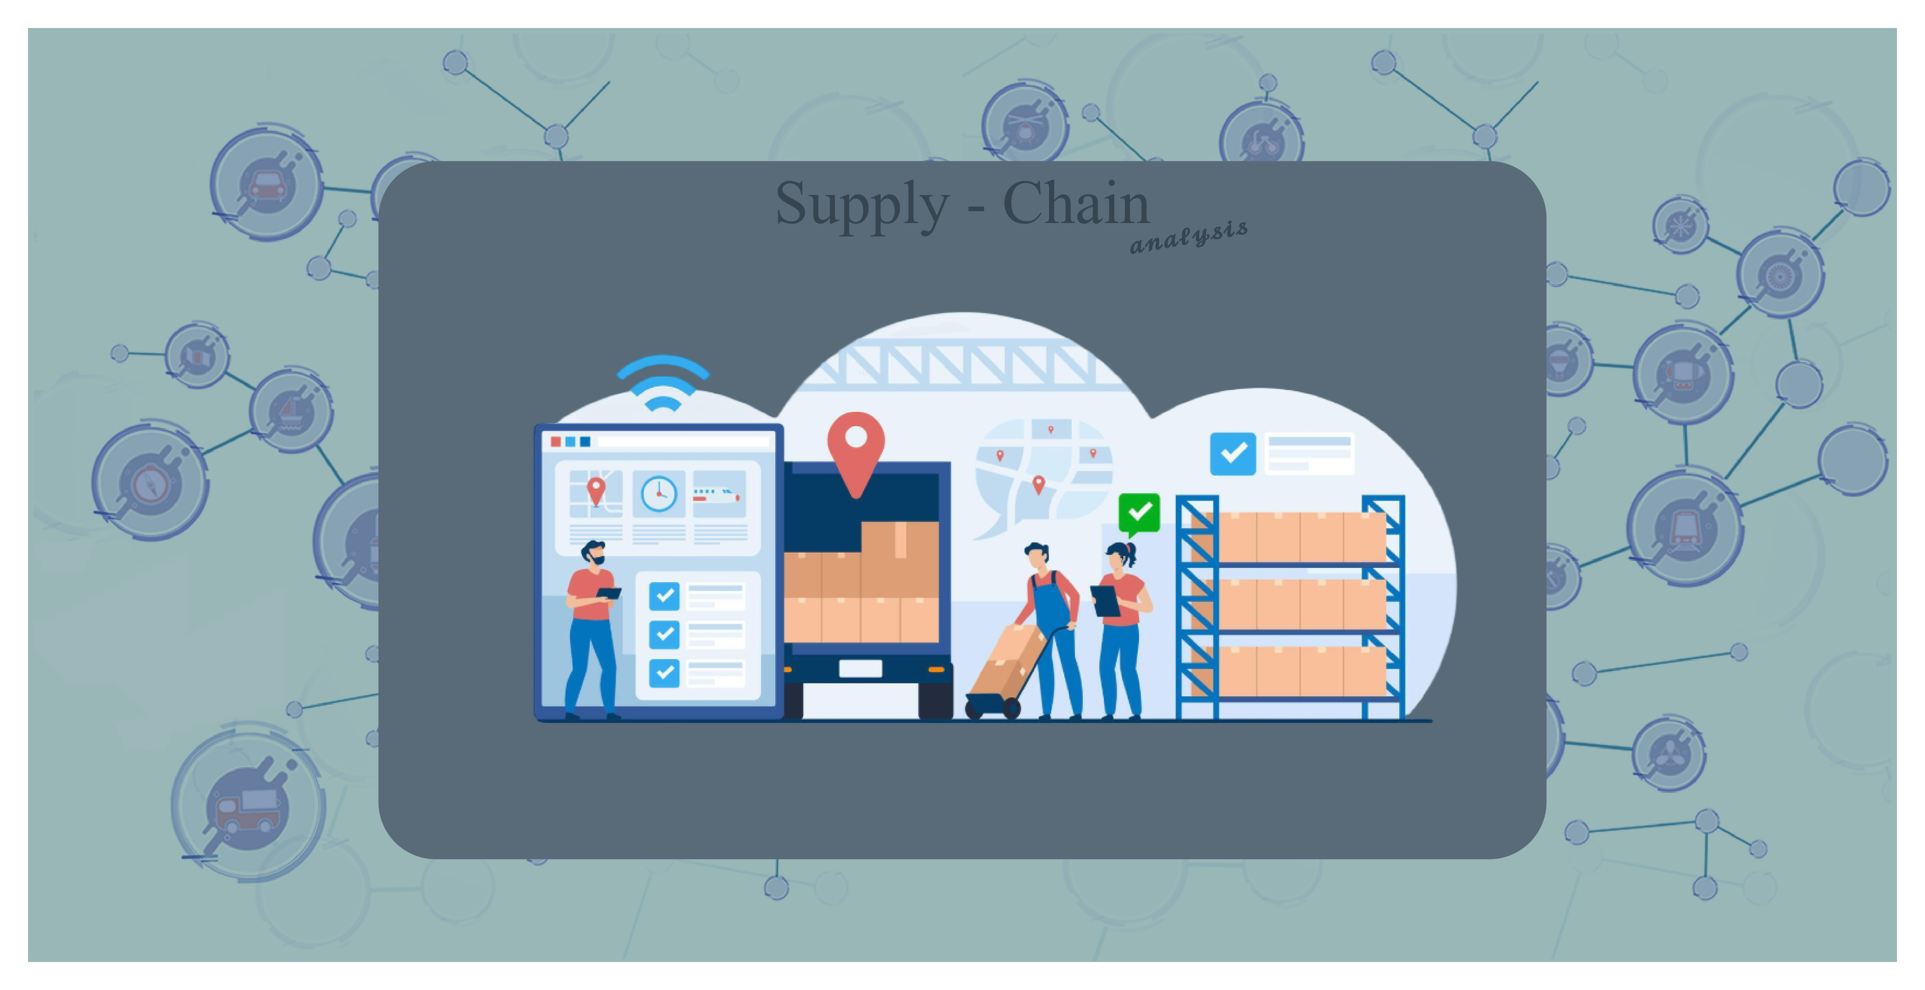

Presented by
Youssef Shaban ـــــــــ Ahmed Salem ـــــــــ Khaled Mohamed
Abdelrahman Elfar ـــــــــ Ahmed Mohamed

Slide 2

Project Idea
Brief Description of The Problem: Supply chains face significant challenges such as delivery delays, supplier performance, logistics efficiency, product quality, and cost control. The project aims to achieve efficient supply chain Objectives by analyzing operational data and generating predictive Recommendations that achieve better goals, reduce waste, and enhance customer experiences.
The Proposed Solution:
1- Data cleaning and preparation to ensure Quality and Accuracy.
2- Interactive Dashboards using Power BI or Tableau for real-time Decision Support.
3- Actionable forecasts to optimize Delivery Delays and Product Quality.
What makes us unique:
Data Accuracy & Safety :- Our processes prioritize data quality, ensuring that all analysis is based on clean, reliable, and well-structured data Using advanced algorithms to achieve high performance
Customized Solutions :- We tailor our dashboards, reports, and models to meet the specific needs of each project
Cross-Departmental Collaboration :- We work closely with all departments (engineering, operations, business, etc.) to ensure our analyses are relevant, impactful, and aligned with real-world needs.
Full integration with Tools :- like Power BI and Custom Python Libraries
Storytelling with Data :- We believe in the power of visual storytelling—translating complex data into clear, compelling narratives that drive engagement and understanding.
Insight-Driven Approach :- We don’t just provide data—we deliver actionable insights that directly support decision-making and strategic planning.
Deliverables:
Strategic recommendations, predictive models, and effective interactive BI dashboards for supply chain models

Slide 3
Data Structure
1. Data Understanding
Data Source
File: supply_chain_data.csv
Format: CSV
Size: 100 records, 30 columns
Content: Comprehensive supply chain data covering product types (haircare, skincare, cosmetics), pricing, sales, revenue, customer demographics, inventory, logistics, and quality metrics.
Data Structure
The dataset includes:
Numerical Columns: Price, Revenue generated, Stock levels, Lead times, etc.
Categorical Columns: Product type, Supplier name, Inspection results, etc.
Key Observations:
Three product types: haircare, skincare, cosmetics.
Potential redundancy in columns like "Lead times" and "Lead time" requires validation.
Columns like "Defect rates" (per batch) and "Defect rate per product%" (per unit) serve distinct purposes but need clear documentation.
Targeted Questions
The dashboard aims to answer:
Supplier Performance: Which suppliers are most efficient in terms of delivery lead times and shipping costs?
Product Performance: Which products generate the highest revenue and sales?
Cost Analysis: How do shipping and manufacturing costs impact profitability?
Customer Insights: Which demographic groups purchase each product type the most?
Quality Control: Which products have high defect rates, and how can quality be improved?
Logistics Efficiency: Which transportation modes and routes are most cost-effective and time-efficient?

Slide 4
Programming Languages & Frameworks
Programming Language Used:
Python – for data cleaning, preprocessing, and
KPI calculations using Pandas and Jupyter Notebook
Frameworks / Tools:
Power BI – used to build the interactive dashboard and visual reports
Pandas – for data manipulation and analysis
Matplotlib / Seaborn – for visualizing outliers during preprocessing
Supporting Technologies:
CSV Files – as the main data source (our_data.csv, Supply Chain Data Cleaned.csv)
Excel – for organizing initial data before visualization
Power BI Service – to publish and share the final dashboard
Word – for Making Documentation
PowerPoint

Slide 5
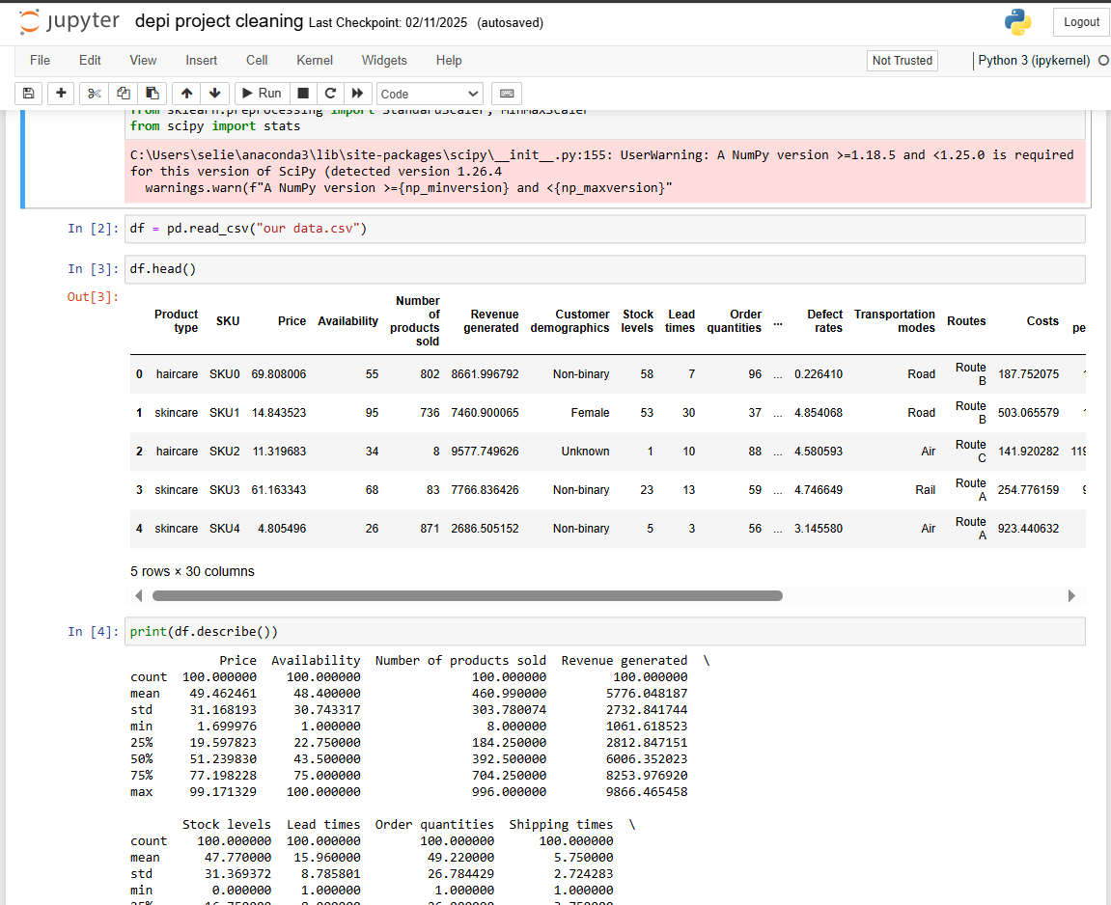
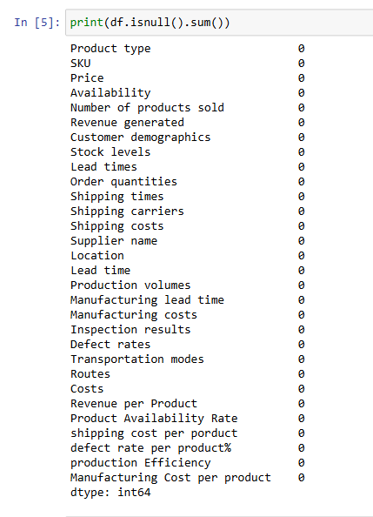
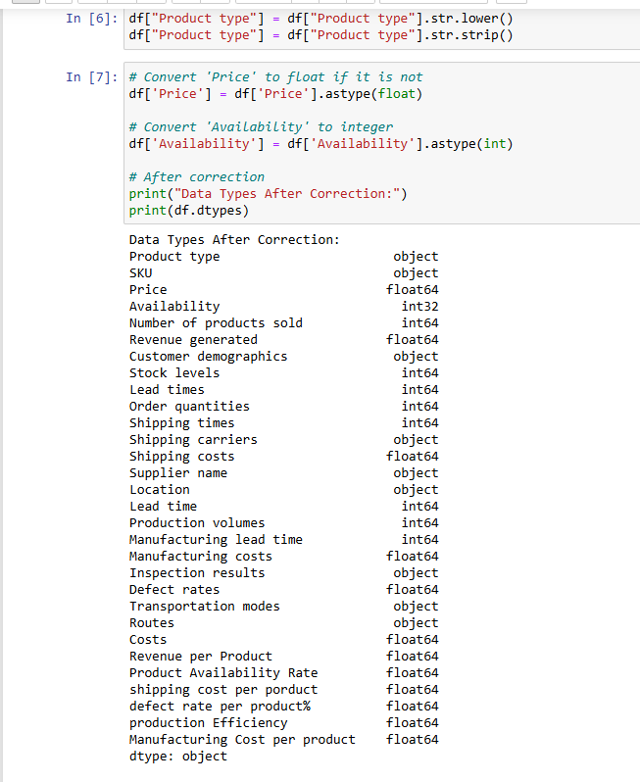
Programming Languages & Frameworks
. Data Cleaning and Preprocessing
Steps Performed :-
Loading the Data :-
Used Pandas: df = pd.read_csv("our_data.csv").
Explored with df.head() and df.describe() to confirm structure and statistical summaries.
Checking for Missing Values :-
Ran df.isnull().sum() to confirm no missing values across all 30 columns.
Correcting Data Types :-
Verified with df.dtypes:
Numerical columns (e.g., Price, Revenue generated) as float64 or int64.
Categorical columns (e.g., Product type, Supplier name) as object.

Slide 6
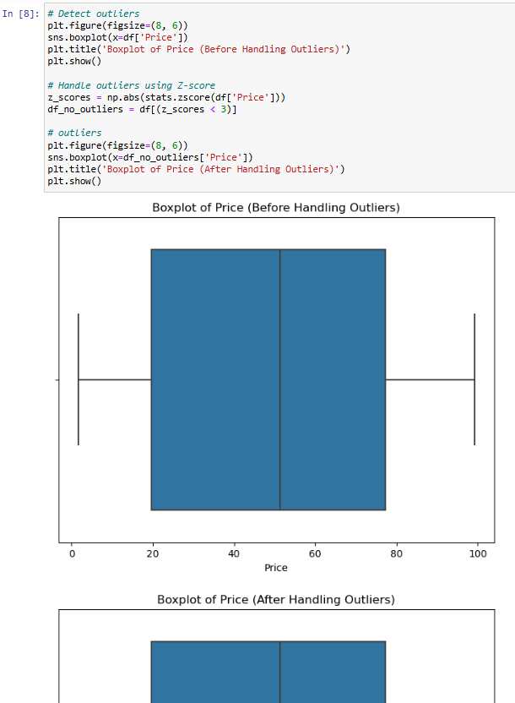
Programming Languages & Frameworks
. Data Cleaning and Preprocessing
Standardizing Defect Rate Metrics:
Clarified that "Defect rates" measures defects per batch, while "Defect rate per product%" measures defects per unit. Both retained for distinct KPI calculations.
Handling Outliers:
Used boxplots to identify outliers in the Price column, ensuring data consistency.
Standardizing Numerical Data:
Applied Standard Scaler to the Price column to normalize its distribution for analysis.
Saving Cleaned Data:
Exported to Supply Chain Cleaned Data.csv for use in subsequent analysis and visualization.
Key Outcomes
Complete Dataset: No missing values, ensuring robust analysis.
Consistent Data Types: Numerical and categorical columns correctly formatted.
Outlier Management: Addressed anomalies in Price to improve data quality.
Standardized Metrics: Ensured defect rate metrics are clearly defined and ready for KPI development.
Next Steps
Use the cleaned dataset to develop KPIs and visualizations.
Address potential redundancies (e.g., Lead times vs. Lead time) during KPI design.
Build the dashboard to provide actionable insights based on the targeted questions.

Slide 7
Programming Languages & Frameworks
. Data Cleaning and Preprocessing
KPIs
Key Performance Indicators (KPIs)
The following KPIs were defined to measure supply chain performance and guide dashboard development :-
Revenue per Product:- Total revenue divided by the number of products sold, indicating average revenue per unit.
Product Availability Rate:- Availability divided by total products, multiplied by 100, to measure inventory availability.
Shipping Cost per Product:- Total shipping costs divided by the number of products sold, to assess per-unit shipping expenses.
Defect Rate per Product %:- Defect rates divided by production volumes, multiplied by 100, to evaluate product quality.
Production Efficiency:- Production volumes divided by manufacturing lead time, to measure production process efficiency.
Manufacturing Cost per Product:- Manufacturing costs divided by production volumes, to determine per-unit manufacturing costs.
Role of KPIs
These KPIs will drive the dashboard's visualizations and insights, addressing key questions about supplier performance, product profitability, cost management, quality control, and logistics efficiency.
They provide a foundation for identifying trends, optimizing operations, and improving decision-making in the supply chain.

Slide 8
Project Deliverables
Timeline & Milestones:
Week 1:Data Reading & understanding
Week 2 : Data cleaning & Preprocessing
Week 3: Data Analysis & KPI development
Week 4: Start Design Dashboard Power BI
Week 5: Dashboard Development, Evaluation and Final Adjustments
Week 6: Writing Report (Insights, Recommendations and Documentation)
Final Products:
Cleaned dataset (Supply Chain Data Cleaned.csv)
Python Source Code (for Preprocessing & KPI Calculations)
Fully functional Power BI dashboard (Supply Chain Project.pbix)
Published Dashboard via Power BI Service & GitHub

Slide 9

Thank You
Visit Our Web Portfolio
https://lnkd.in/dUWsfTKK

